Slide 1

Presented By:
Madhav Maheshwari
Isha Agrawal
Gaurav Kumar Tiwari
Presented To:
Mr. Akash Kumar Choudhary
(Technical Trainer)
GLA University,
Mathura

Slide 2
Food Delivery WebApp

Slide 3
Topics to be covered:
Introduction
What is the need of Food Delivery WebApp?
Technologies Used
Project Model View
Features
Advantages
Conclusion

Slide 4
Introduction:
The purpose of a food delivery web application is to provide users with a convenient, fast, and hassle-free way to order food from their favorite restaurants..
The web app typically allows users to browse through a list of Categories, view their menus, and place orders for delivery.
Overall, a food delivery web application is a useful tool for both consumers and businesses alike, providing a seamless way to order food online and have it delivered right to your door.

Slide 5
What is the need of Food Delivery webApp?
Convenience: Customers want a quick and easy way to order food ,with a few clicks, customers can browse menus, place orders, and have food delivered right to their doorstep.
Variety: A food delivery web app allows customers to access a wider variety of food.
Time-saving: Ordering food through a food delivery web app saves customers time.
Contactless delivery: With the ongoing pandemic, many customers prefer contactless delivery options, and food delivery web apps provide just that.

Slide 6
Technologies Used:
React JS:
ReactJS is an open-source JavaScript library that is widely used for building user interfaces. It was developed by Facebook and is currently maintained by Facebook, Instagram, and a community of developers.
ReactJS allows developers to build reusable UI components, which makes it easier to maintain and scale applications.

Slide 7
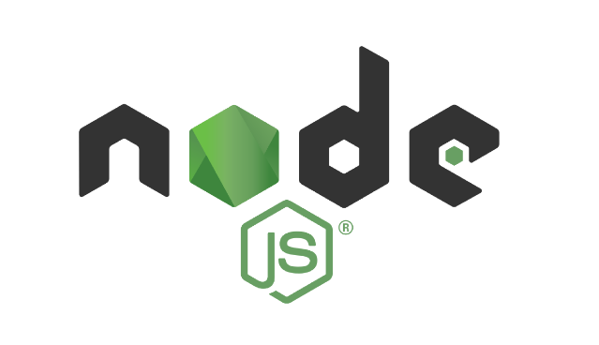
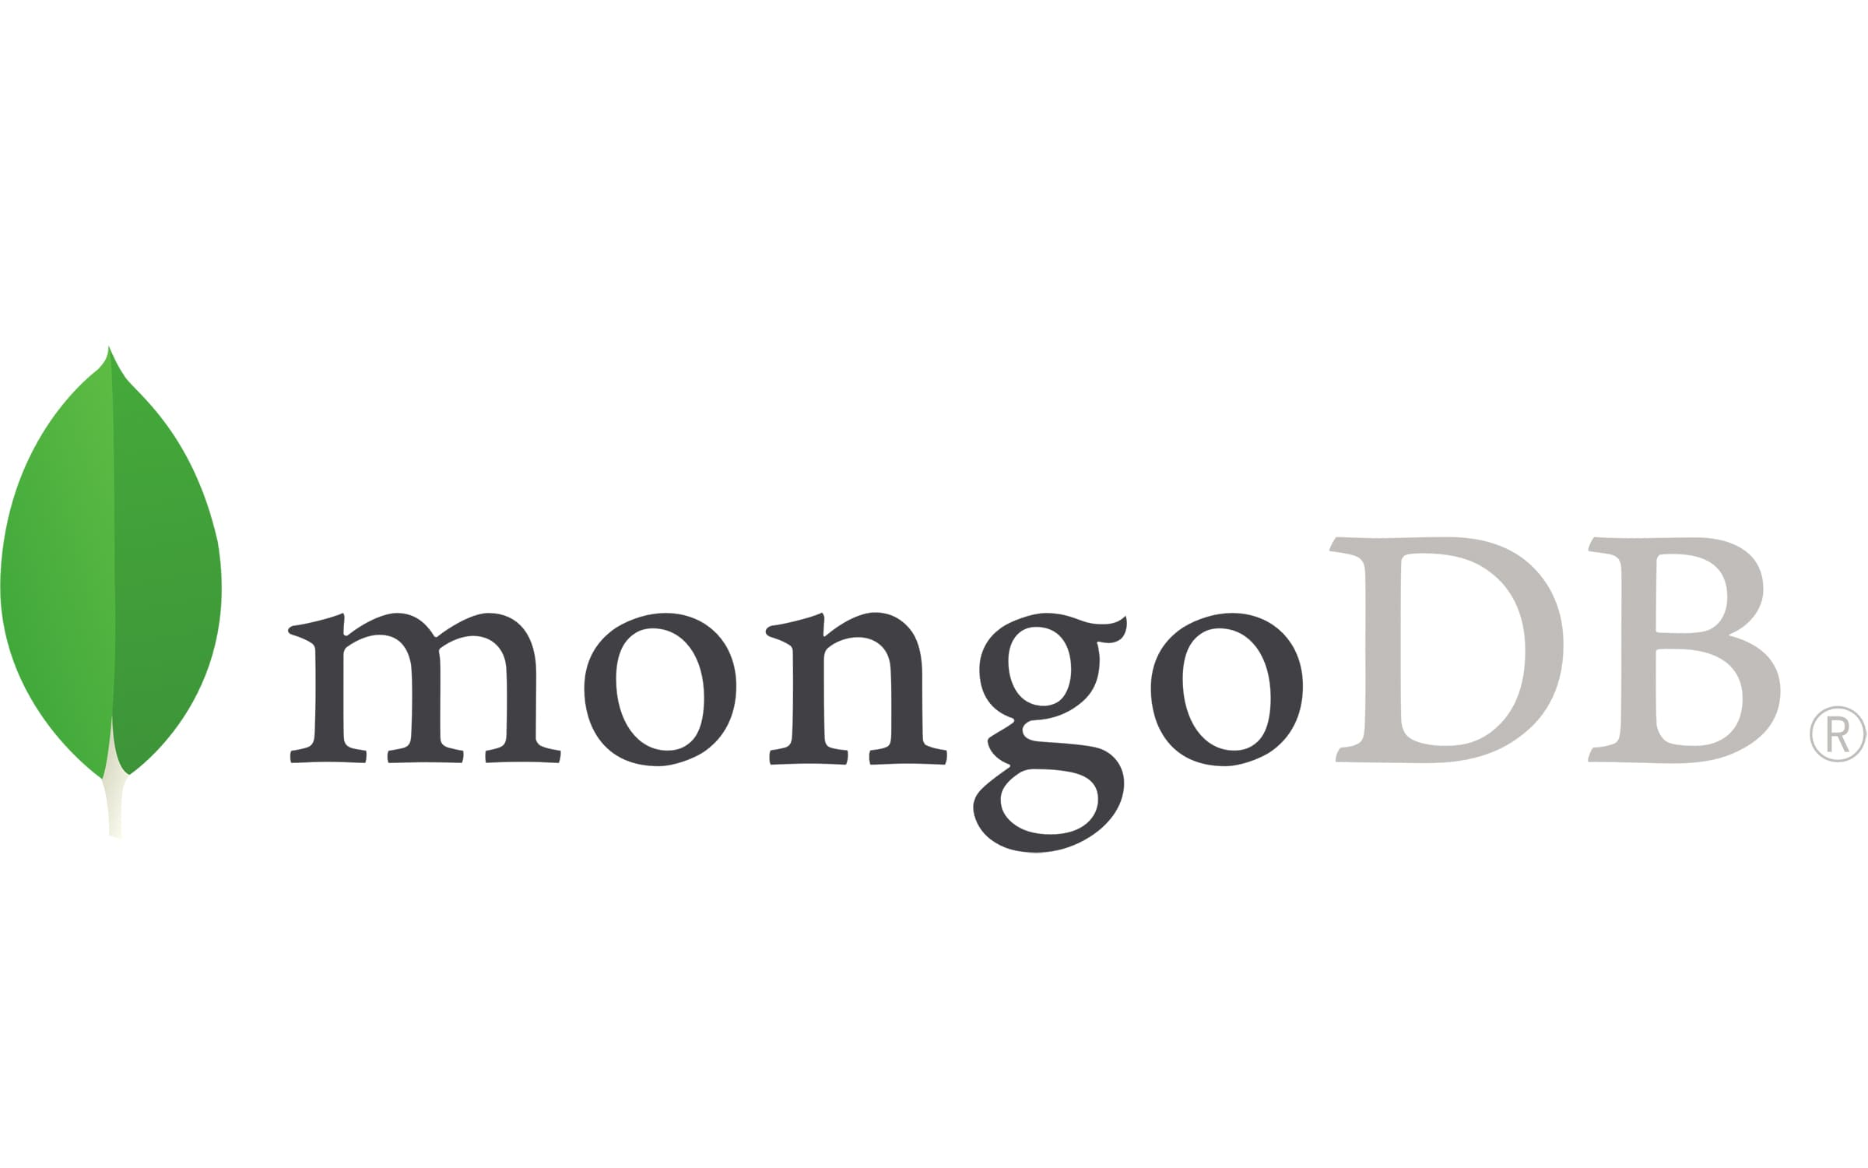
Node JS:
Node.js is an open-source, cross-platform, server-side runtime environment built on Chrome's V8 JavaScript engine. It allows developers to build scalable, high-performance, and networked applications using JavaScript, a language traditionally associated with front-end web development.
Mongo Db:
Mongo db. is an open-source NoSQL database management program. NoSQL as a alternative to traditional relational database. NoSQL database are quite useful for working with large sets if distributed data. Mongo DB is a tool can manage document-oriented information, store are retrieving information.

Slide 8
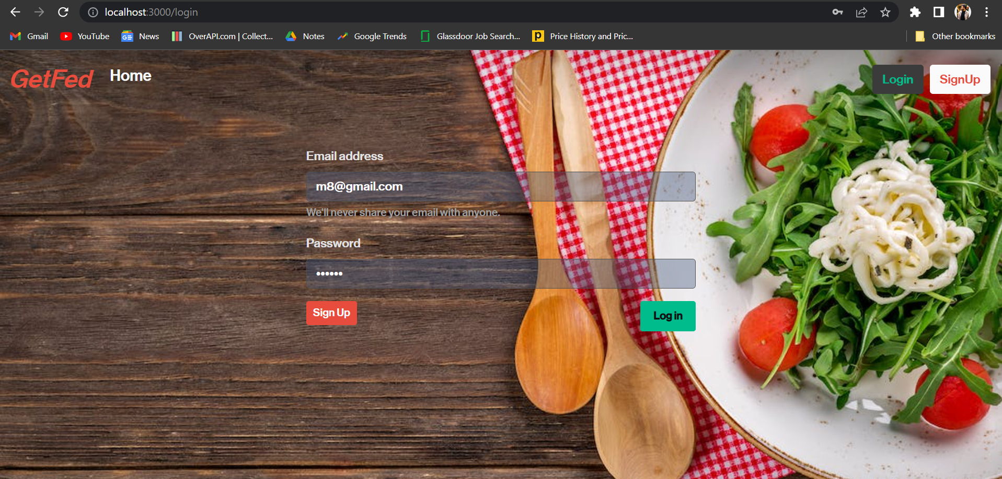
Project Model View:
For signing in to the application user must have an account
User has to enter his/her valid email id and password to access the application
Users wont be able to Sign in unless he/she has a valid User account
Sign in screen:

Slide 9
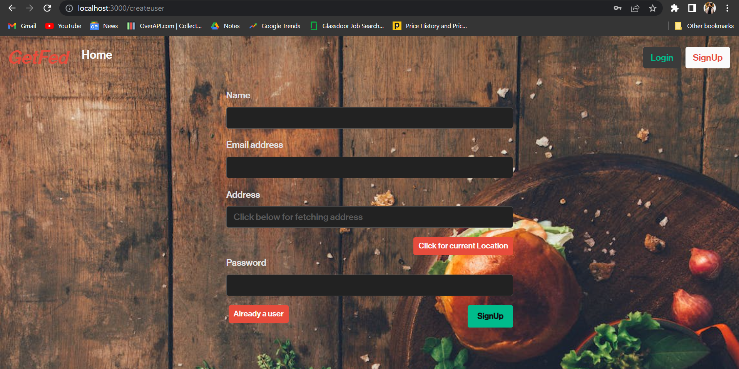
Sign up Screen:
This page allows the user to create a new account.
User have to enter a valid user name ,email id(Unique) and password to create a new account.

Slide 10
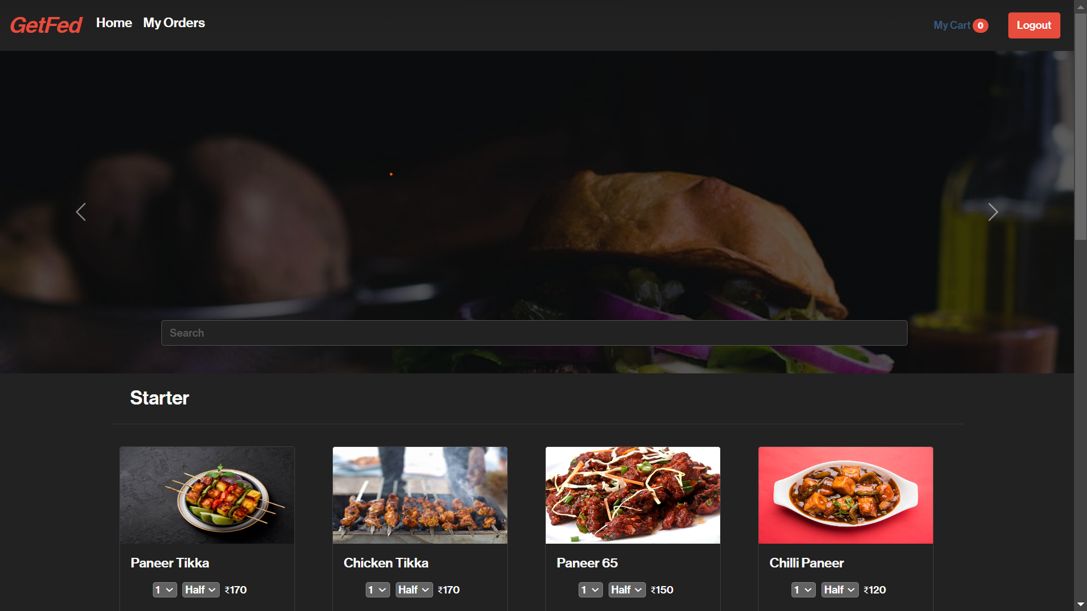
Home Page:
This is the main page of the application from where user can access the whole application
User can reach to the different sections of the application from this page
This page shows the different categories of the food present in the restaurant.

Slide 11
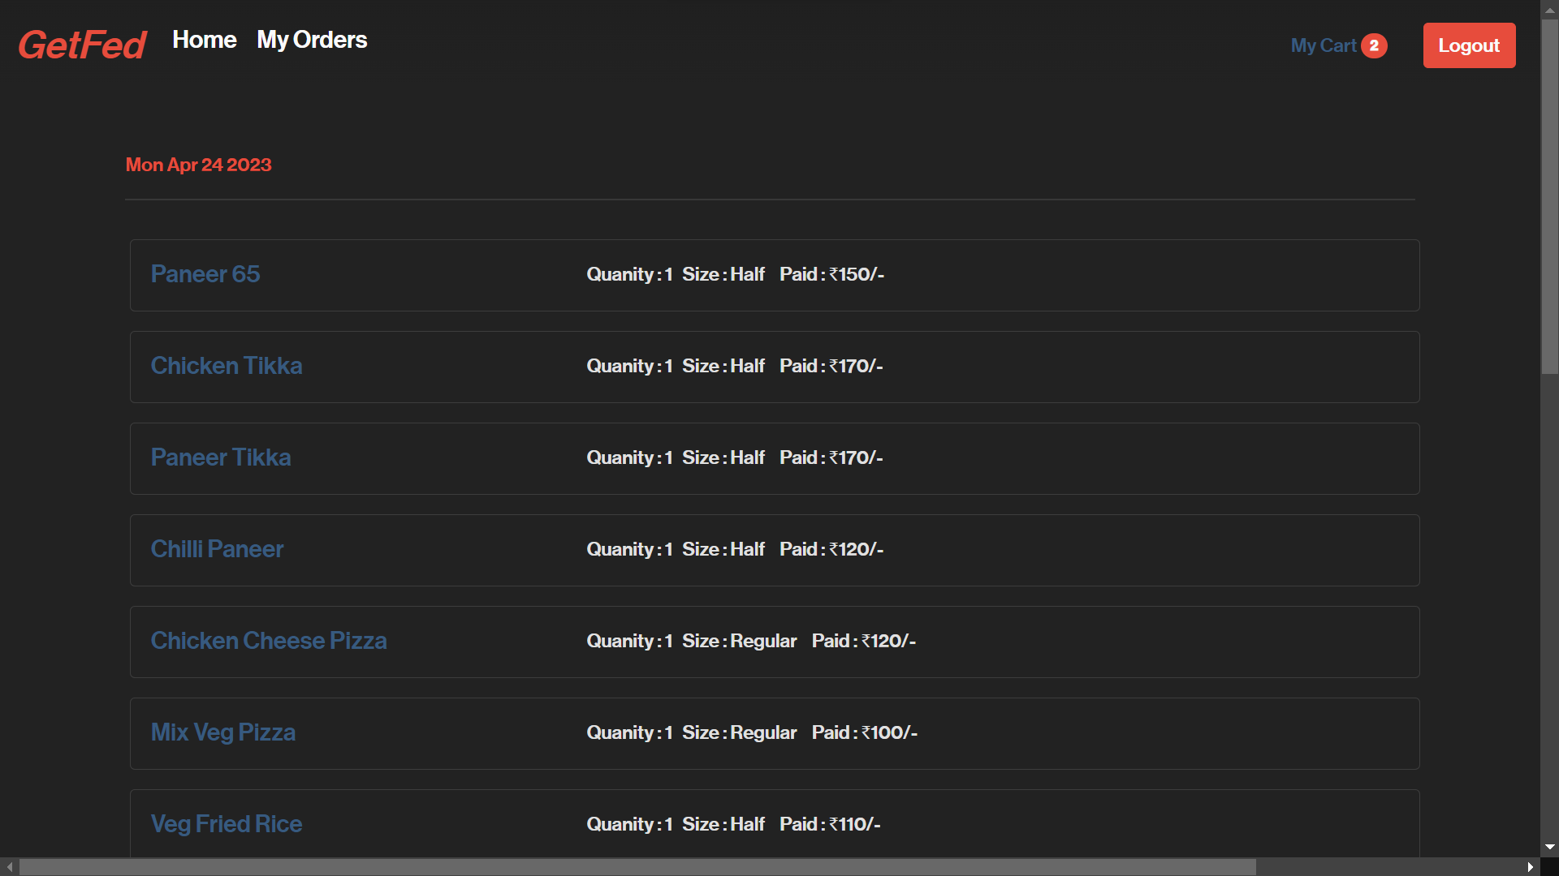
My Orders:
This Page is used to show the Food you Ordered
With the following data like name, quantity, size and prices in Categorical format with respect to Date.

Slide 12
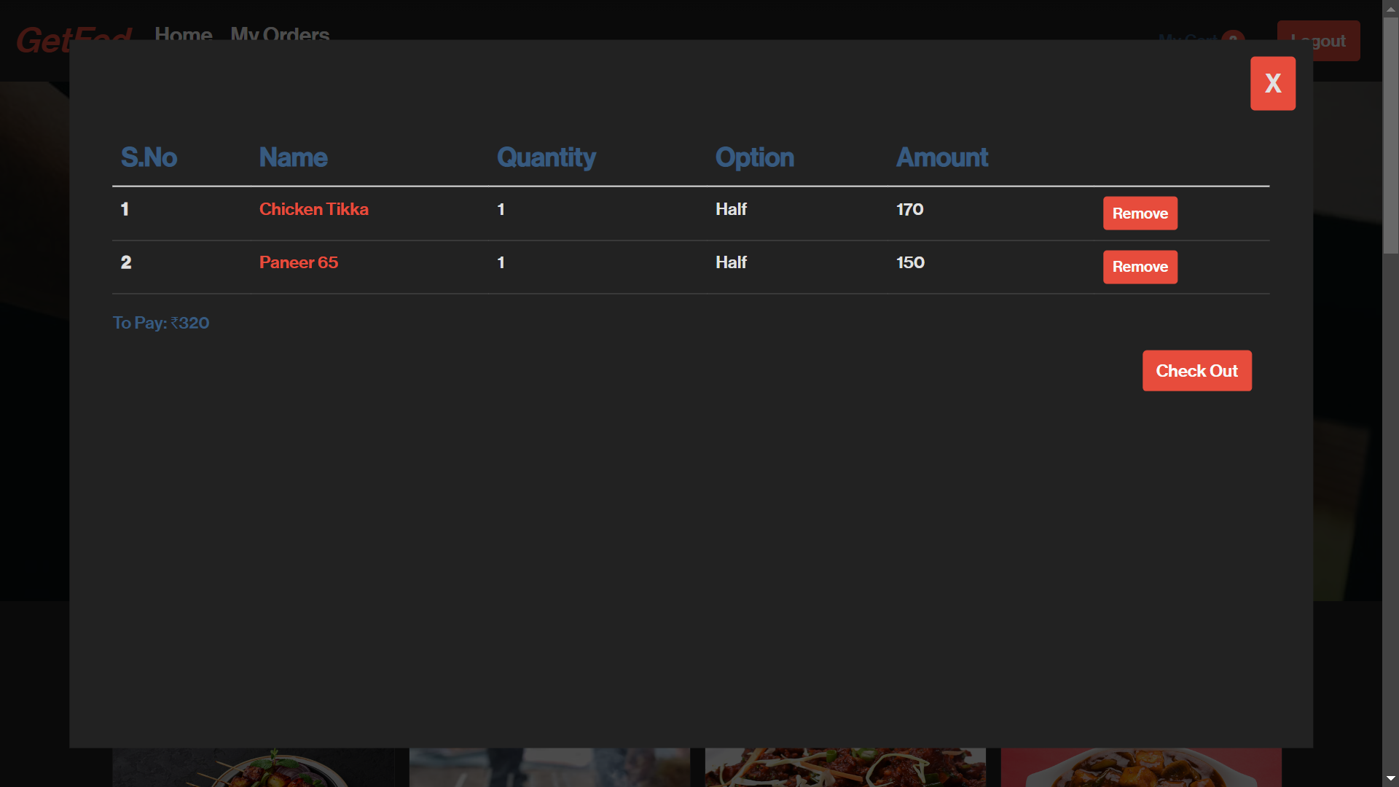
My Cart Page:
This page of the application shows the Cart View .
You can Check Out the dishes or remove the dishes.

Slide 13
Features:
Ordering and checkout
Confidentiality of User’s Data

Slide 14
Advantages:
Convenience
Time Saving
Wide Variety of Option
Easy ordering

Slide 15
Conclusion:
In conclusion, a food delivery web app is a useful and convenient tool for customers who want to order food online and have it delivered to their doorstep
Food delivery web apps have also become an important part of the restaurant industry, providing a platform for restaurants to reach new customers and increase their revenue.
Overall, a food delivery web app can be a valuable tool for both customers and restaurants, but it is important to consider the potential drawbacks and take steps to address any issues that arise.

Slide 16
Thank You

